Slide 1
Software Development Life Cycle (SDLC) Models
SDLC and SDLC models definitions, types of SDLC models, pros and cons of different SDLC models, comparative characteristic of SDLC models

Slide 2
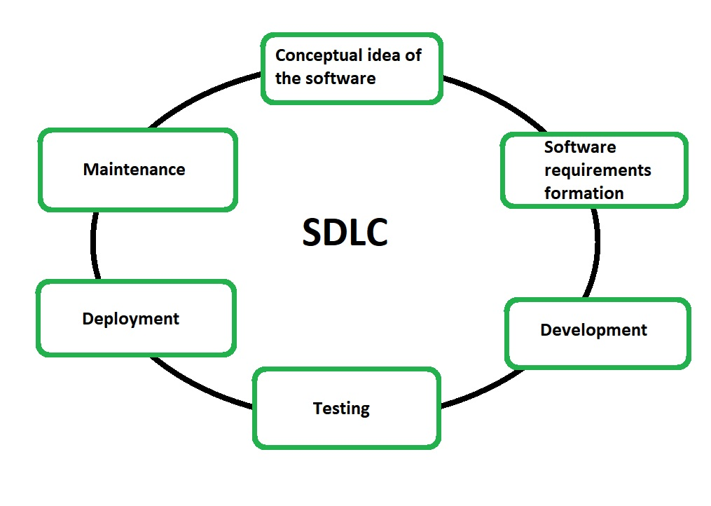
The Software Development Life Cycle (SDLC) is a period of time from the conclusion a decision about the creation of the software to a moment of the software complete decommissioning.
The Software Development Life Cycle (SDLC) consists of such stages:

Slide 3
Software Development Life Cycle (SDLC) model is a framework, that describe all activities in a software development project from planning to maintenance.
The most important and popular SDLC models are:
- Waterfall model
- Iterative model
- Spiral model
- V-model

Slide 4
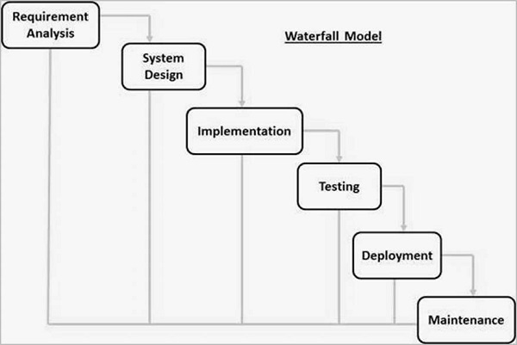
The Waterfall model is the earliest SDLC model, that was used for software development. In a waterfall model, each phase must be completed before the next phase beginning and there is no overlapping in the phases. The software development process is a linear flow.

Slide 5
Waterfall pros:
- Model is simple and easy for understanding and using.
- The progression of Waterfall is intuitive and does not require training.
- Model determines the end goal early.
- Model is easy to manage due to the rigidity of the model (each phase has specific deliverables and a review process).
- Model phases are processed and completed one at a time. Phases do not overlap.
- Waterfall model works well for smaller projects where requirements are very well understood and/or for short (<= one year) projects.
Waterfall cons:
- It is very difficult to go back and change something.
- Excludes the client and/or end user (do not focus on them) during development.
- No working software or functionality is produced until late during the software development life cycle.
- High amounts of risk and uncertainty.
- Not a good choice for a long, complex, ongoing projects.
- Not suitable for the projects where requirements are at a high risk of changing
- It is difficult to measure progress within stages.
- Cannot accommodate changing requirements.

Slide 6
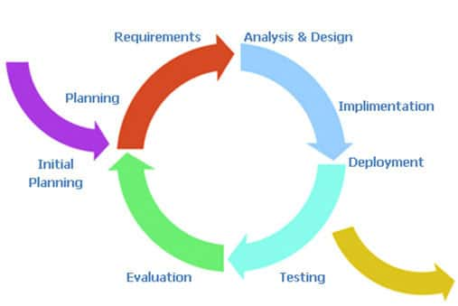
The Iterative model is a dividing of the software development of a large application into smaller pieces (iterations). It is possible to start with only some of the software requirements and develop the first version of the software. With each iteration, new requirements are added and new version (new functionality) of the software is produced. The process is repeated until all requirements are implemented and software is fully developed.

Slide 7
Iterative model pros:
- Working functionality can be developed early.
- Operational product is delivered with every increment.
- It is not necessary to have a full and complete, final list of requirements.
- It is easily adaptable to the changing.
- It is best suited for agile organizations.
- It is more cost effective to change the scope or requirements in Iterative model.
- Testing during small iteration is easy.
- Testing begins on early phases.
- Risks are lower (risks are identified on each iteration and are resolved during the iteration) and each iteration is easily managed.
- Documentation is easy.
- Suitable for large and mission-critical projects
Iterative model cons:
- Software issues and mistakes in design may arise, because not all requirements are gathered at the beginning.
- More resources may be required.
- More management attention is required.
- Defining increments (iterations) may require the definition of the complete system.
- Not suitable for smaller projects.
- End of project may not be known which is a risk.
- Projects progress is highly dependent upon the risk analysis phase.

Slide 8
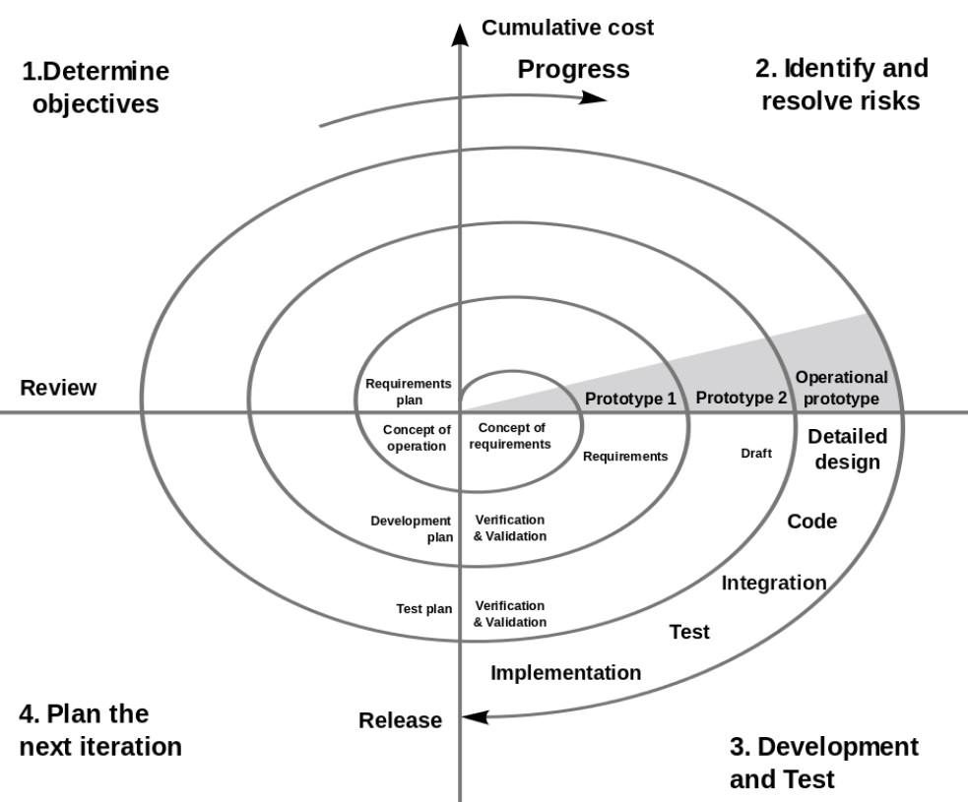
The Spiral model is a combination of the iterative development model and the waterfall model with a very high attention on risk analysis. The spiral model has four phases (Determine objectives, Identify and resolve risks, Development and Test, Planning the next iteration). A software project repeatedly passes through these phases by the spiral until achieving the final product . Each spiral is a creation of a fragment or a version of the software, it clarifies the objectives and characteristics of the project, determines its quality and plans the work of the next coil of the spiral.

Slide 9
Spiral model pros:
- Avoidance of risk is enhanced, suitable for high risk projects, high amount of risk analysis.
- Good for large and mission-critical projects, requiring continuous enhancement.
- Strong approval and documentation control.
- Additional functionality can be added at a later date.
- Software is produced early in the software life cycle.
- A highly customized product can be developed.
- Changing requirements can be accommodated.
- Software and/or working functionality is produced early in the SDLC.
Spiral model cons:
- Management is more complex.
- End of the project may not be known early.
- Not good for small or low risk projects.
- Could be expensive.
- Process is complex
- Large number of stages requires large number of documentation.
- Risk analysis requires highly specific expertise and skills

Slide 10
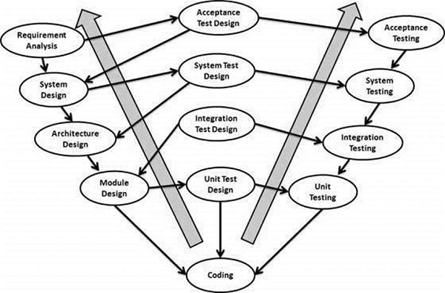
The V-model is an extension of the waterfall model and is based on the association of a testing phase for each corresponding development stage. The V-model is a model where execution of processes happens in a manner of a V-shape. There is a directly associated testing phase for every single phase in the development cycle. The corresponding testing phase of the development phase is planned in parallel.

Slide 11
The V-model pros:
- Testing activities starts early, before coding. Defects are found on early stages. Every development stage has corresponding testing activity.
- This is a highly-disciplined model, which phases are completed one at a time.
- Works well for smaller projects where requirements are very well understood.
- Simple and easy to understand and use.
- Easy to manage. Each phase has specific deliverables and a review process.
The V-model cons:
- It is very difficult to go back and change something.
- No working software or functionality is produced until late during the software development life cycle.
- Moderate risk and uncertainty.
- Not a good model for, long, complex, object-oriented projects, ongoing projects.
- Not suitable for the projects where requirements are at a high risk of changing.

Slide 12
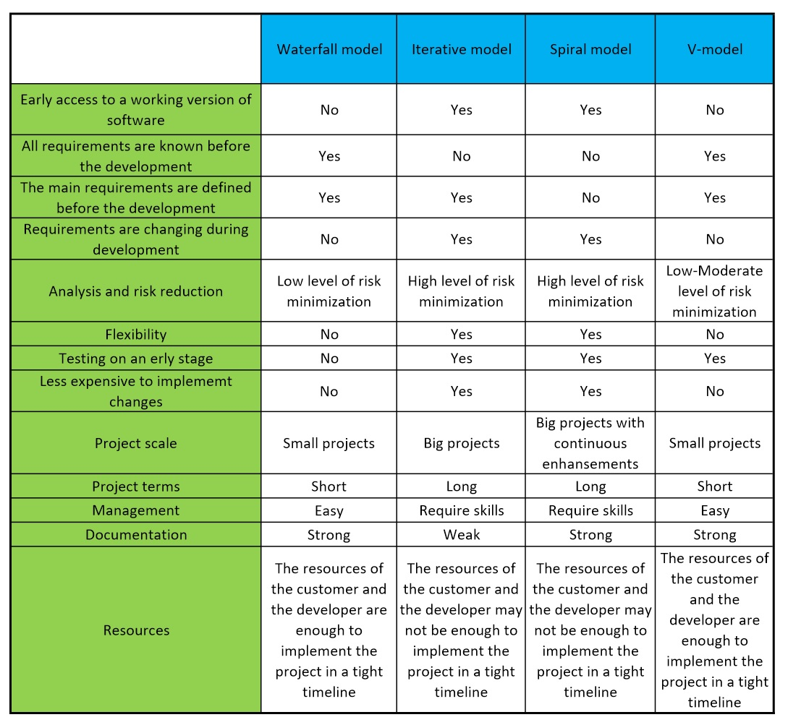
Comparative characteristic of SDLC models
Comparative characteristic of SDLC models

